Slide 1



LOGOS
SIMILARITY
THIRA SCHEITZNER EDUARD PAUL
2025

Slide 2



Task
Match and group websites by the similarity of their logos.
Logos are instrumental for a company’s identity – they’re the symbol that customers use to recognize your brand. Ideally, you’ll want people to instantly connect the sight of your logo with the memory of what your company does – and, more importantly, how it makes them feel.

Slide 3

Clustering
Criteria
Histograms
Text
Shapes
Used to distinguish logos based on dominant colors and hue family
Extracting dominant letters from the dataset and the dominant words
Observing the domminant shapes inside the logos

Slide 4

Core
Technologies
EASYOCR
is a python Computer optical character recognition module which is recognised for its flexibility and uncomplicated interface. It is mostly used for image analasys and data entry automation
MATHPLOT
Used for the graph generation and visualasation of the results
NUMPY
for extracting data from the histograms
OPENCV AND PIL
For processing the images of the logos

Slide 5
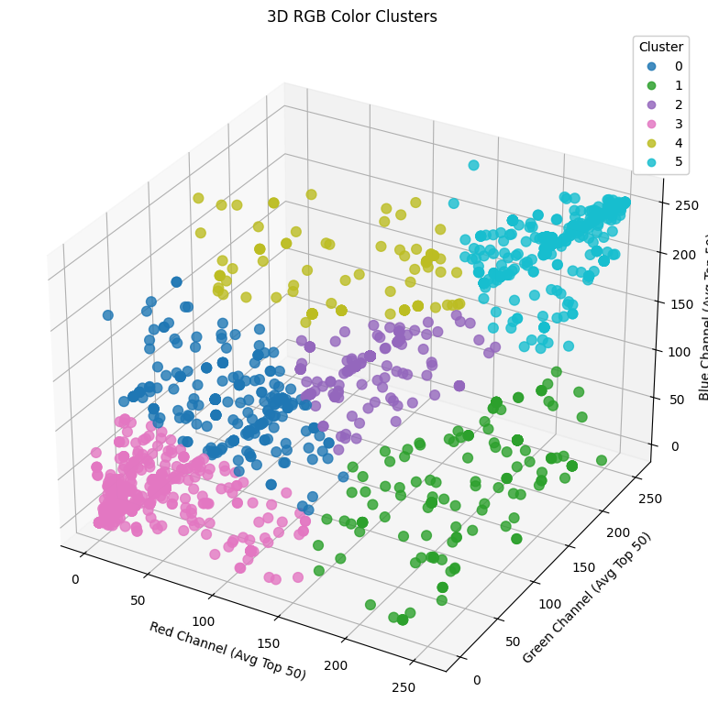
Histogram
Insights
RGB Cluserring 3D
From the chart we can clearly observe that most logos tend to have a lot of reds and pinks as you can observe in the pink cluster, while the cyan one is a close second, representing the blues and greens. The other 4 clusters are equally proportional and less condensed and represent the light and dark greens, navy blues and purples

Slide 6
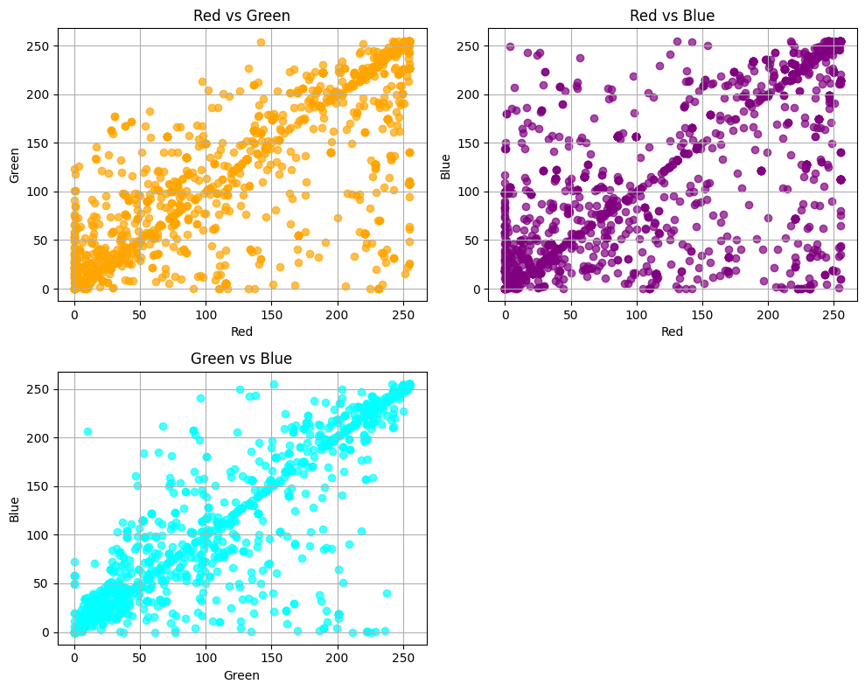
Histogram
Insights
RGB Cluserring
Here I have charted how each component is dependent on the other and as we can observe that red and blue value tend to be more extreme and are less balanced so we have a lot of logos with either red or blue as dominant channel, while the green channel tends to be more average in values as we can observe from its dependency from the blue channel, while its dependency with red is a bit more drastic but not as much as the red blue dependency

Slide 7
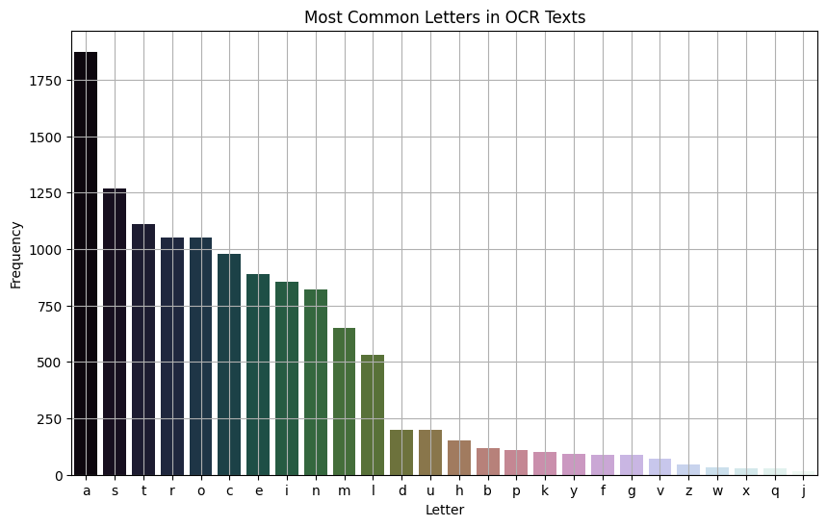
Text
Insights
Common Letters
From this chart obtained from extracting the text from the logos we can see a clear dominance of the letter A, while letters S,T,R,O,C,E follow with similar values, which aligns well with the most dominant letters in the english language E, T, A, O, I, N, S, R, H, and L. We can also notice that between the letters A and S and the letters L and D is a big difference in occurances despite having neighbouring ranks

Slide 8
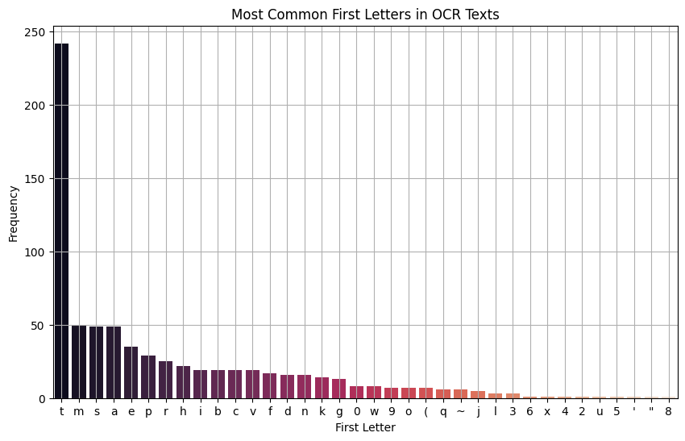
Text
Insights
First Letters
In this chart we can visualise the how many logos begin with how many logos begin with a certain letter and as we can see that by a wide margin most logos begin with the letter T which could be indicative of the fact that most companies in the dataset are tech related

Slide 9
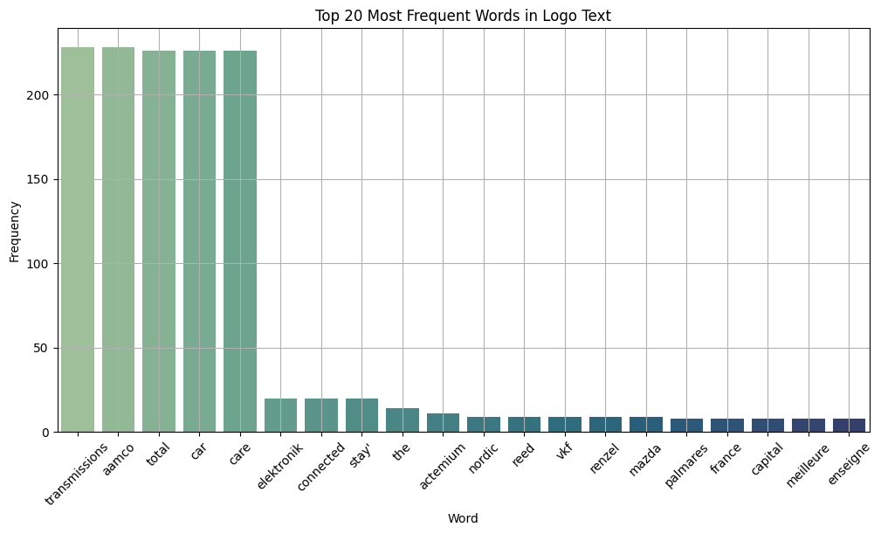
Text
Insights
Common words
From this graph that represents the most common words present in the logos we can see that the top 5 words are transmissions, aamco, car and care which can suggest a common theme of transports and cars for the logos

Slide 10
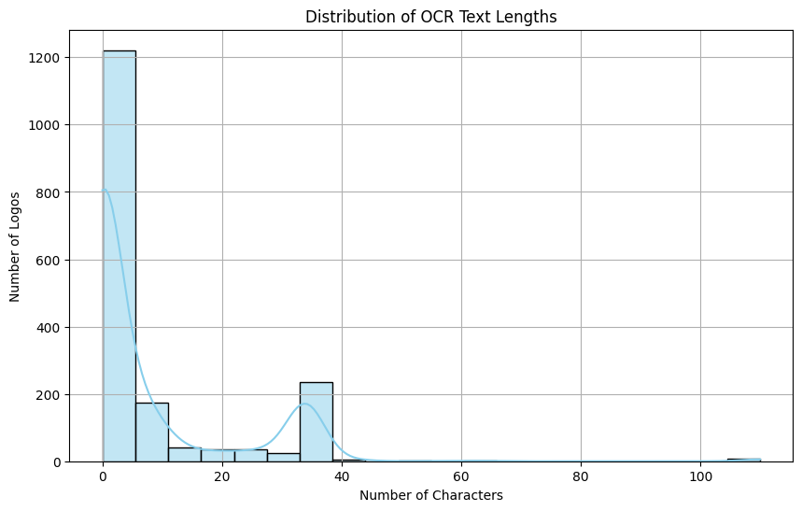
Text
Insights
Logos length
As expected most logos have a length of less than 10 characters but what was unexpected was a group of distinct logos that had between 35-40 characters which could suggest that the dataset contained logos from family owned companies

Slide 11
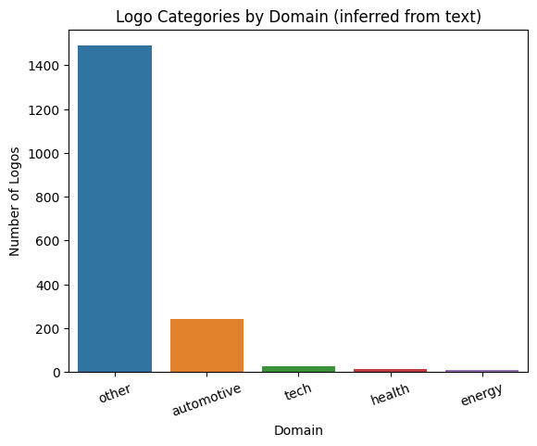
Text
Insights
Domains
As the chart clearly states, the domains of the logos are extremely varried and could be sorted into 30+ categories

Slide 12
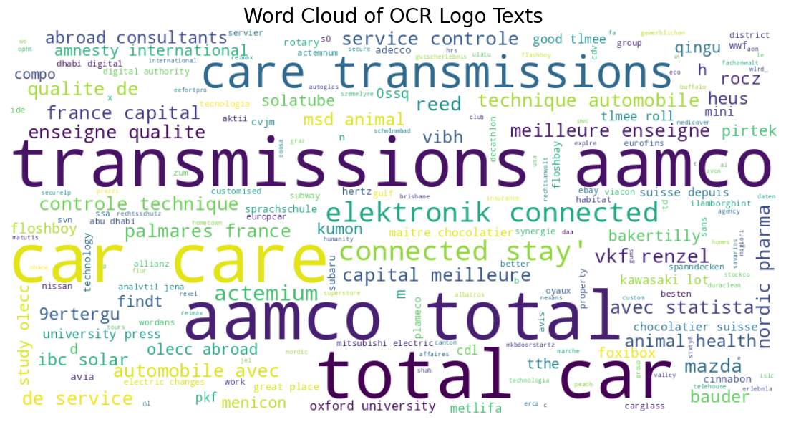
Common
Words

Slide 13
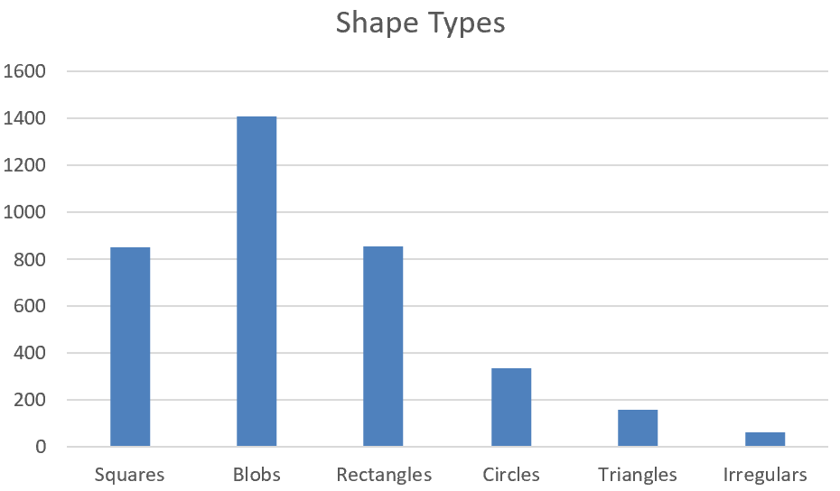
Shape
Clusters
In this we can see the shape distribution and we can clearly see a strong dominance for blobs squares and rectangles for the logo design which might correlate with the minimalism trend that has emerged in the designs of many companies

Slide 14
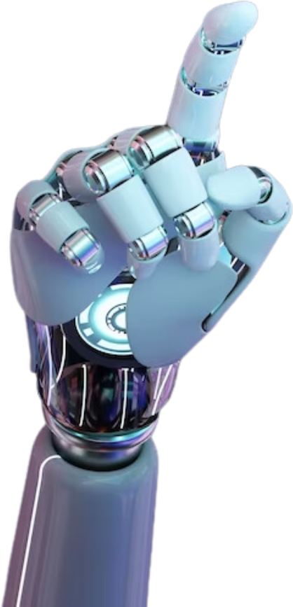
Conclusion
Summary
From this dataset I can clearly conclude that the companies were very diverse and that most logos had either a warm pallete which could have been to be more welcoming for customers or very dominated by blues and greens which could align with the heavy preponderce for the tech and transport companies that the logos represented
page 14

Slide 15
THANK YOU!
page 15

